Slide 1

Vel Tech Rangarajan Dr. Sagunthala R&D Institute of Science and Technology
School of Computing
Department of Computer Science and Engineering
10211CS224 / FULL STACK APPLICATION DEVELOPMENT (JAVA)
PROJECT REVIEW : MILESTONE PROJECT – 1
Date: 06-05-2026
Ticket Booking Management
SDG: 9 – Industry, Innovation and Infrastructure
Presented By:
E.K.V.L Pujitha – VTU25880 – 23UECS0172
Courses Handling Faculty:
Dr. HAFIZUR RAHMAN - M. Tech., Ph.D
Assistant Professor

Slide 2
INTRODUCTION
1
The Ticket Booking System is a web-based application developed to simplify the process of booking tickets for internal department events such as technical fests, seminars, and workshops. In many institutions, ticket booking is still handled manually or through basic forms, which often leads to errors such as overbooking, incorrect data entry, and inefficiency in managing ticket availability.
To overcome these challenges, this project proposes a React JS-based solution that provides a dynamic and user-friendly interface. The system allows users to view event details, enter booking information, and reserve tickets online. By incorporating validation mechanisms and real-time updates, the application ensures accurate and efficient ticket booking. The use of modern frontend technologies enhances performance, responsiveness, and user experience.
2
3
4
5
6
7
8
9

Slide 3
PROBLEM STATEMENT
1
2
In traditional systems, event ticket booking is often managed manually or through simple forms without proper validation. This creates several issues such as overbooking of tickets, lack of real-time updates on ticket availability, entry of incomplete or invalid user data, and poor user experience. These problems highlight the need for an automated system that can handle bookings efficiently while maintaining data accuracy.
The absence of a structured and interactive booking system makes it difficult to manage events effectively. Therefore, there is a need to develop a system that provides real-time booking, ensures validation of user inputs, and offers a user-friendly interface for seamless interaction.
3
4
5
6
7
8
9

Slide 4
OBJECTIVE(S)
1
The main objectives of this project are:
To design and develop a web-based ticket booking system using React JS
To display event details such as name, date, venue, and ticket price clearly
To allow users to book tickets online through a structured form
To validate user inputs such as name, email, and ticket count
To prevent booking more tickets than available
To display booking confirmation and summary after successful booking
To improve overall user experience using a dynamic and responsive interface
2
3
4
5
6
7
8
9

Slide 5
PROPOSED SYSTEM
1
The proposed system is a React-based ticket booking application that provides an efficient and automated solution for managing event bookings. It allows users to access event details and book tickets through an interactive interface.
The system includes features such as input validation, ticket availability checking, and booking confirmation. It ensures that users cannot book more tickets than available, thereby preventing overbooking. The application dynamically updates ticket availability after each successful booking.
The system is designed to be simple, efficient, and easy to use, making it suitable for internal departmental events. It reduces manual effort and improves accuracy in booking operations.
2
3
4
5
6
7
8
9

Slide 6
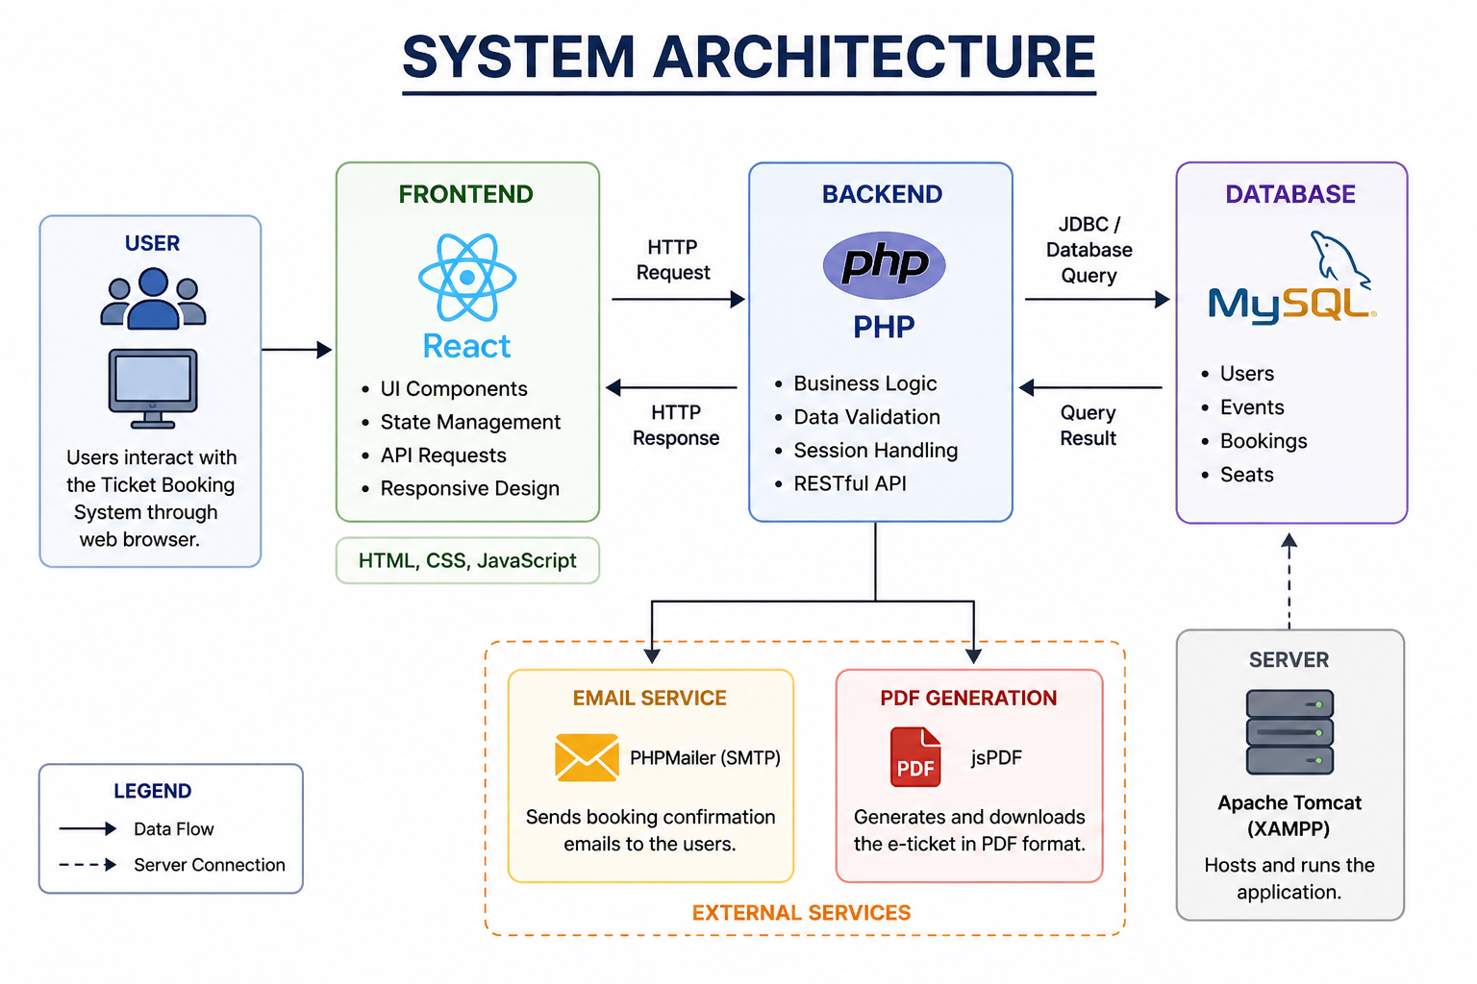
PROPOSED SYSTEM ARCHITECTURE
1
2
3
4
5
6
7
8
9

Slide 7
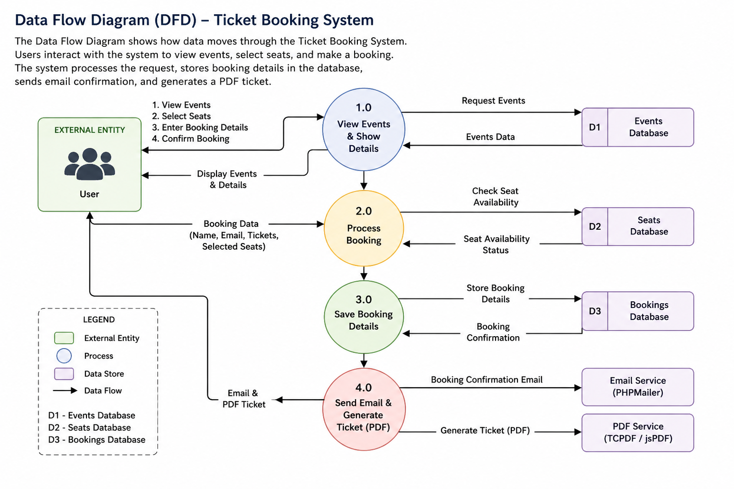
WORKFLOW
1
User opens the application
Views event details
Enters booking details (name, email, etc.)
System validates input
Checks ticket availability
Books tickets if valid
Displays booking confirmation and summary
2
3
4
5
6
7
8
9

Slide 8
TECHNOLOGIES USED
1
2
The project is developed using modern web technologies:
React JS: Used for building the user interface and handling dynamic content
HTML5: Provides the structure of the web application
CSS3: Used for styling and layout design
JavaScript (ES6): Handles logic, event handling, and validation
VS Code: Development environment for writing code
Web Browser: Used to run and test the application
3
4
5
6
7
8
9

Slide 9
MODULE DESCRIPTION
1
The system is divided into several modules for better organization and functionality:
Event Details Module: Displays event information such as name, date, venue, price, and available tickets
Booking Module: Collects user details and processes ticket booking
Validation Module: Ensures all inputs are valid, including email format and ticket count
Ticket Management Module: Updates available tickets and prevents overbooking
Booking Summary Module: Displays booking confirmation along with user details
Each module performs a specific function, ensuring smooth operation of the system.
2
3
4
5
6
7
8
9

Slide 10
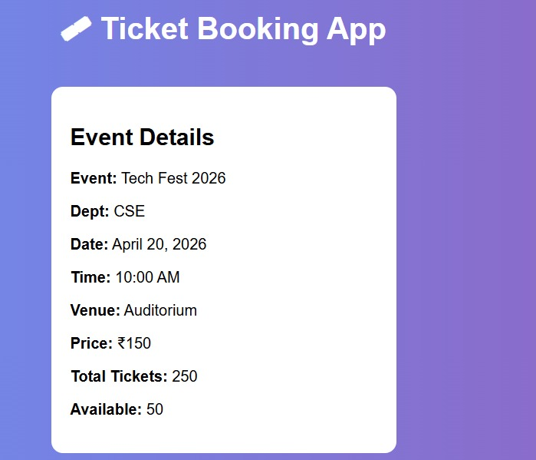
IMPLEMENTATION SCREENSHOTS
1
2
3
4
5
6
7
8
This section displays complete event details such as event name, date, time, venue, price, and ticket availability. It helps users understand the event information clearly before proceeding with ticket booking.
9

Slide 11
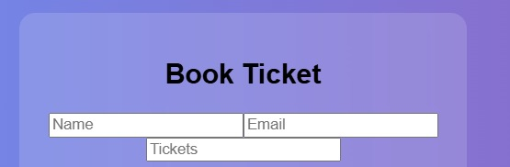
IMPLEMENTATION SCREENSHOTS
1
2
3
4
5
6
7
8(A)
This section allows users to enter their booking details such as name, email, and number of tickets. It collects and validates user input before proceeding to seat selection and booking.
9

Slide 12
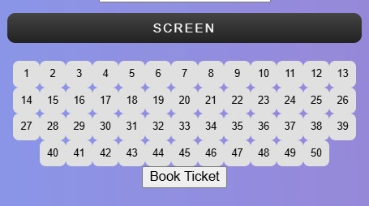
IMPLEMENTATION SCREENSHOTS
1
2
3
4
5
6
7
8(B)
This section displays a seat layout where users can select their preferred seats for booking. Selected seats are highlighted, ensuring users choose the correct number of seats before confirming the booking.
9

Slide 13
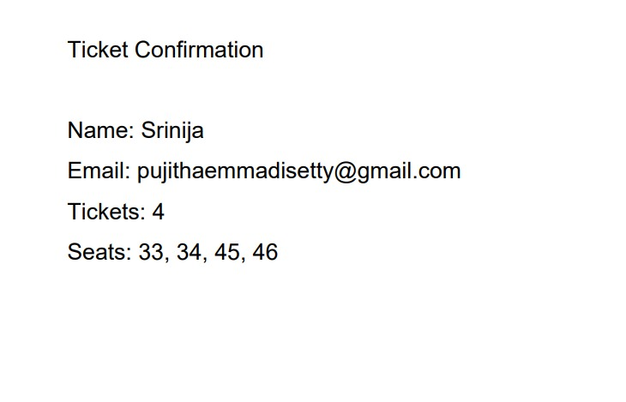
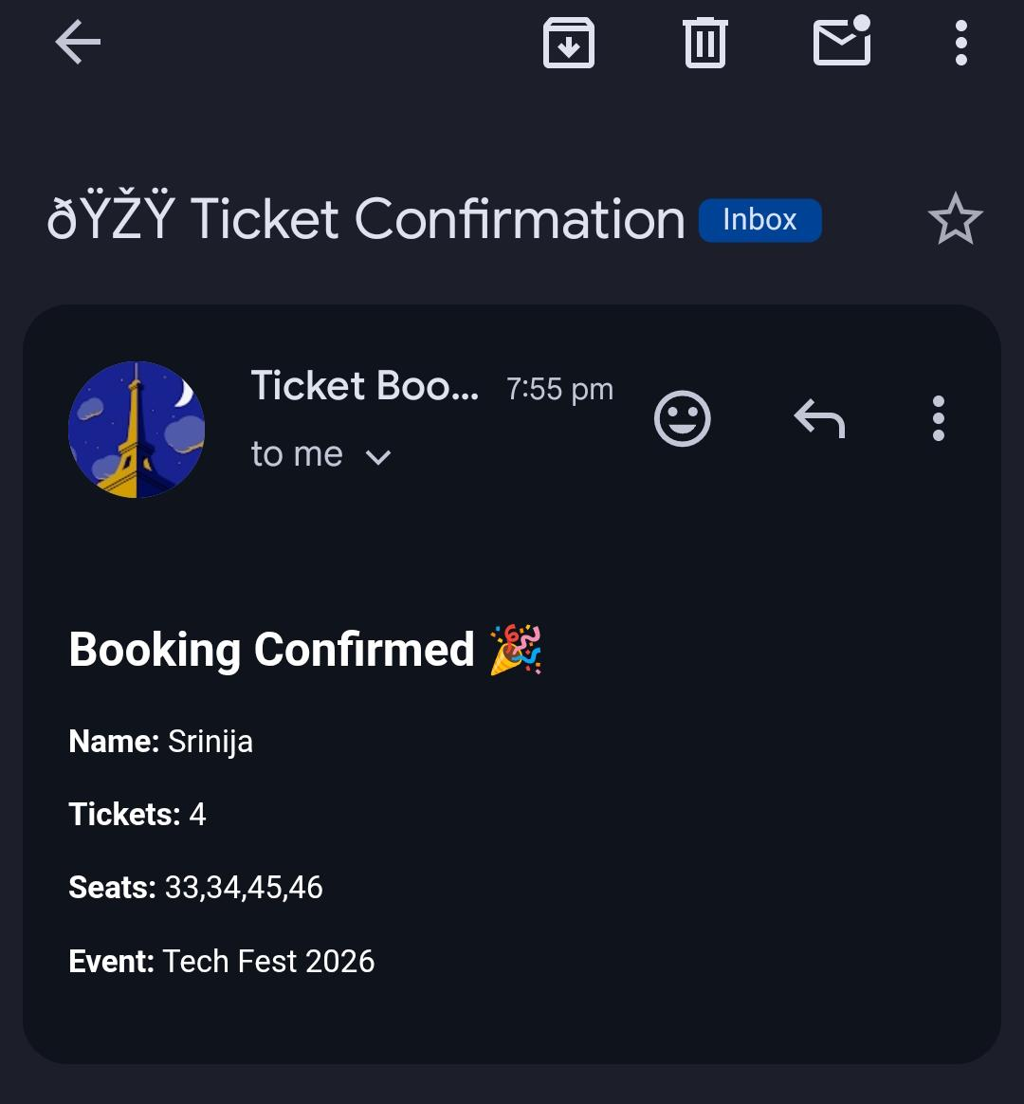
IMPLEMENTATION SCREENSHOTS
1
2
3
4
5
6
7
8(C)
This section displays the ticket confirmation details after a successful booking, including user name, email, number of tickets, and selected seats. It confirms that the booking process is completed successfully and provides a clear summary for the user. Additionally, it allows users to download the ticket and receive confirmation via email.
9

Slide 14
ADVANTAGES & LIMITATIONS
Advantages
Easy to use and user-friendly interface
Prevents overbooking using validation
Provides real-time ticket availability updates
Ensures data accuracy
Fast and responsive using React
Reduces manual work and errors
Limitations
Does not store booking data permanently (no database in PPT version)
No user authentication system
Supports only a single event
Basic UI design
No payment integration
1
2
3
4
5
6
7
8
9

Slide 15
Thank you

